Slide 1

QER 10356
QER: MERAKES EAST PROJECT SF216608C002.01 – Intermittent superficial scratches

Slide 2
Pipe section / Details
Item | Traceability / identification
Project number | SF216608C002
Project name | MERAKES EAST PROJECT
Pipe section | SF216608C002.01
ST number | ST254.72048
Affected layer / equipment | Zeta vault spiralling
Length affected | 0m until 291m
Drawing number / MP code / STA / Dimension | ZETA 12 FI 11(MP746)

Slide 3
Overview of anomaly
Problem Description :-
During the zeta spiraling of MERAKES EAST PROJECT SF216608C002.01 (ST254.72048), intermittent superficial scratch due to roller mark on the zeta wire was detected at start length 0m until 291m on pipe.
The details of measurement are as per below.
- Depth: 14um
- Upsetting: N/A
Root Cause :-
The root cause was due to the roller phosphating coating is not suitable for FI11 wire grade.
Problem Handling:-
According to project acceptance criteria CD_216608C002_str25472048_TR01-09_rev0_An_Pressure vault, the maximum allowable criteria for the depth of surface defects is 100um and for the maximum upsetting is 50um. Thus, this defect was accepted as it is.

Slide 4
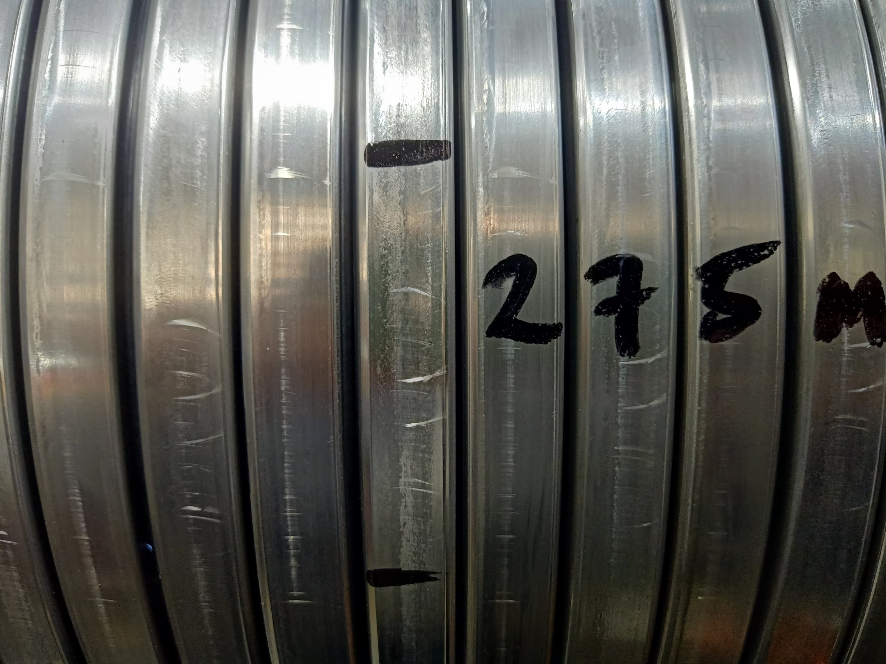
Defect Photo
Figure 1 : Intermittent superficial scratch due to roller mark on the zeta wire was detected at start length 0m until 291m on pipe.

Slide 5
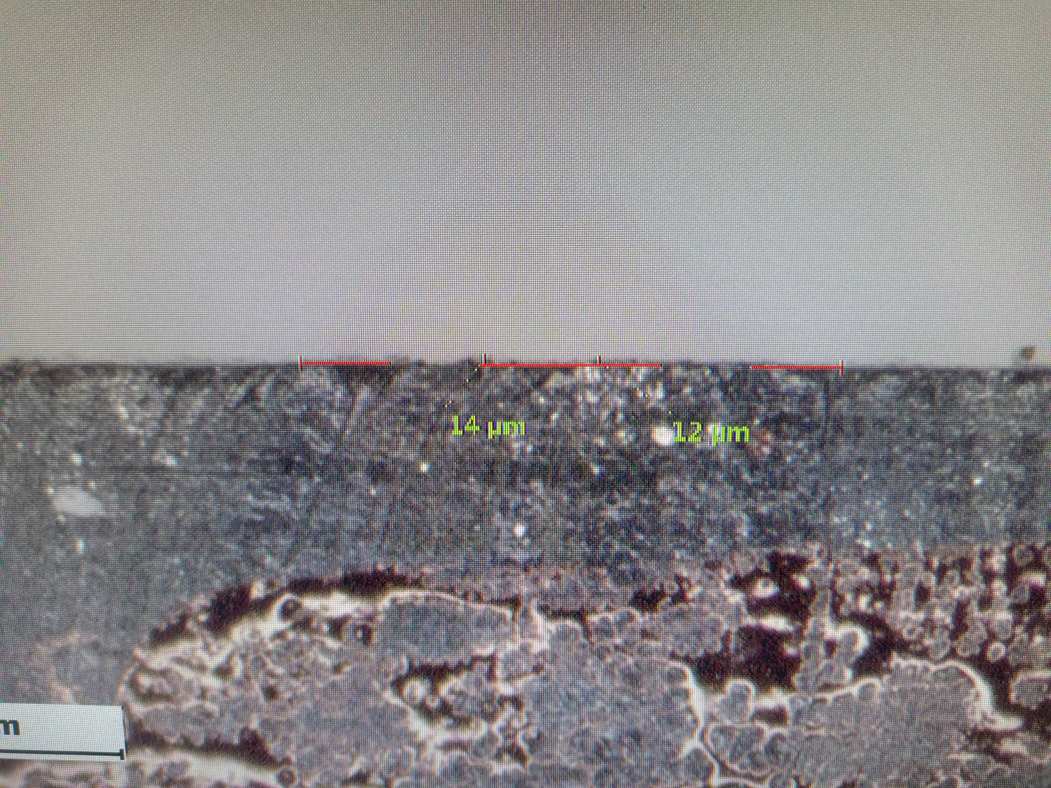
Plastic copy measurement
Figure 2 : According to project acceptance criteria CD_216608C002_str25472048_TR01-09_rev0_An_Pressure vault, the maximum allowable criteria for the depth of surface defects is 100um and for the maximum upsetting is 50um. Thus, this defect was accepted as it is.

Slide 6

THANK YOU

